Slide 1
PROJECT TITLE
PIP2001 Capstone Project
Review-1
Batch Number:
Roll Number | Name
20211CST0037 | Chilamakuri Syam Sundar Reddy
20211CST0013 | Baddi Ganesh Kumar
20211CST0004 | Desu Venkata Naga Sai Sanjay
20211CST0026 | Syamala Mohan Kumar Reddy
Under the Supervision of,
Dr./Mr./Ms./Prof.
Professor / Associate Professor / Assistant Professor
School of Computer Science and Engineering
Presidency University
Name of the Program: Computer scienc
Name of the HoD:
Name of the Program Project Coordinator:
Name of the School Project Coordinators: Dr. Sampath A K / Dr. Abdul Khadar A / Mr. Md Ziaur Rahman

Slide 2
Introduction
In an age defined by relentless technological progress and an unwavering commitment to innovation, the project "Healthcare Access through Portal" emerges as a trailblazing force poised to redefine the very essence of healthcare delivery. This transformative initiative envisions a future where healthcare access transcends traditional boundaries, empowered by a seamlessly integrated and technologically advanced portal.
The "Healthcare Access through Portal" project stands as a beacon of revolutionary change, challenging conventional healthcare paradigms through cutting edge technology and user friendly interfaces that promise unparalleled access to medical resources. Against the backdrop of traditional healthcare systems grappling with inherent challenges, such as limited accessibility, fragmented communication, and delayed interventions, this project represents a pivotal shift towards a future where technology seamlessly bridges these gaps.

Slide 3
Literature Review
Public health communication initiatives must use the most effective strategies for the promotion, protection and maintenance of health. This can be achieved through using the best available evidence to guide and inform practice and policy. Practitioners, programme managers and policymakers need to be aware of what is known about the benefits, risks and costs of communication interventions aimed at the prevention and control of communicable disease.
Summaries of existing knowledge compiled in a series of reviews of what is currently known can provide a powerful resource for practitioners and policymakers. Such reviews also enable researchers to focus their attention on identified gaps in knowledge. This review is one in a series of ‘Insights into health communication’ on the prevention and control of communicable disease in the European context. Due to the diversity of issues relating to the research on health information seeking behaviour on the web from both health consumers’ and health professionals’ perspectives this literature review should be seen as providing an overview of the topics and an introduction to the related issues and policymakers.

Slide 4
Existing method Drawback
The methodology does not explicitly leverage advanced technological tools for data collection and analysis. In an era where technology can significantly augment research efficiency, the underutilization of these tools represents a missed opportunity.
Integrating innovative technologies could not only enhance the depth of analysis but also contribute to a more robust and contemporary research methodology. Additionally, the study's limited attention to issues of reproducibility and generalizability may impact the broader applicability of its findings. A more thorough consideration of these factors, including detailed documentation and transparency in research processes, would bolster the study's methodological soundness and its potential impact on the broader research community.

Slide 5
Proposed Method
1.User-Centered Design.
2. Multi-Functional Features Integration.
3. Data Security and Privacy Assurance.
4. Analytics and Continuous Improvement.
5. Telemedicine Integration for Virtual Healthcare.
6. Community Outreach for Inclusivity.
7. Cost-Effectiveness and Scalability.
8. Research and Continuous Innovation

Slide 6
Objectives
1.User Centric Healthcare Experience
2.Comprehensive and Inclusive Accessibility
3.Robust Security and Privacy Measures
4.Active Patient Engagement
5.Streamlined Appointment Management

Slide 7
Methodology/Modules
1.Positive Transformation in Healthcare Access
2.Improved Patient Pathways
3.Educational Resources, and Appointment Scheduling
4.Advertising Healthcare

Slide 8
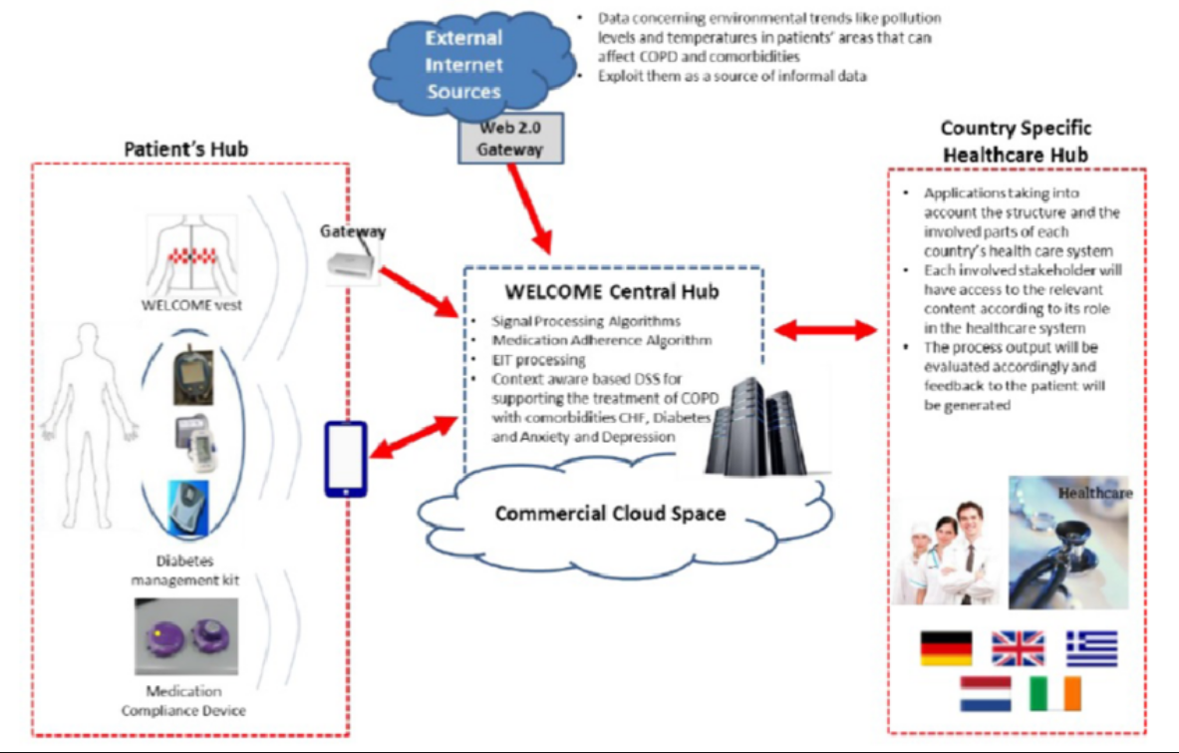
Architecture

Slide 9
Hardware/software components
Hardware Requirements:
1. pc or laptop.
2. server Hardware.
3. operating system.
4. security hardware.
Software Requirements:
1. web server.
2. database management systems.
3. programming languages.
4. front end development.

Slide 10
Timeline of Project
Title o Abstract
Literature Survey – Minimum 10 research papers must be referred.
3. Objectives
4. Existing Methods-Drawbacks
5. Proposed Method o Architecture Diagram
6. Modules
7. Hardware and Software Details
8. Time Line by Gantt Chart
9. References

Slide 11
Expected Outcomes
1.Enhanced Patient Pathways.
2.Reduction in Missed Appointments.
3.Improved Appointment Adherence.
4.Development of Implementation Guidelines.
5.Identification of Crucial Implementation Factors

Slide 12
Conclusion
The User Centric Healthcare Experience initiative emerges as a pivotal force in reshaping healthcare dynamics, prioritizing user convenience, accessibility, and engagement. The development of a user-friendly portal interface is foundational, ensuring that patients can effortlessly navigate and access essential healthcare services. The portal's commitment to streamlined appointment management introduces efficiencies for both patients and healthcare providers, reducing administrative burdens and providing patients with greater control over their scheduling.

Slide 13
Github Link
The Github link provided should have public access permission.
Github Link
: https://github.com/shyamreddy0037/integrated-health-care-portal

Slide 14
References
1.Tustin N. The role of patient satisfaction in online health information seeking. Journal of Health Communication 2010;15(1):317.
2. Sorensen T. Health Trends WHO/health consumer trends survey 2005, presentation at joint meeting of the SANCO Health systems working party and the INFSO health Working group, Luxemburg [cited 1 April 2010].
3. Sillence E, Briggs P, Harris P, Fishwick L. Going online for health advice: changes in usage and trust practices over the last five years. Interacting with Computers 2007;19(3):397406

Slide 15
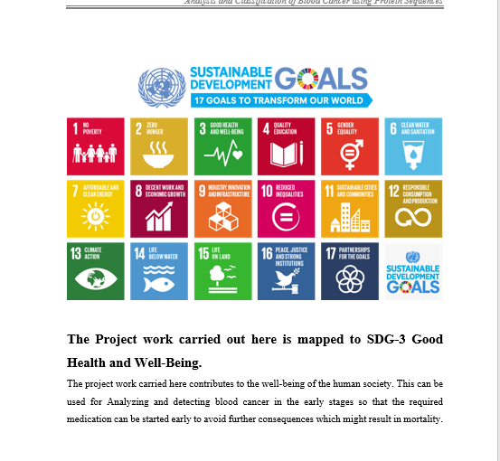
Project work mapping with SDG

Slide 16
Thank You

